Slide 1
Language Processing System

Slide 2
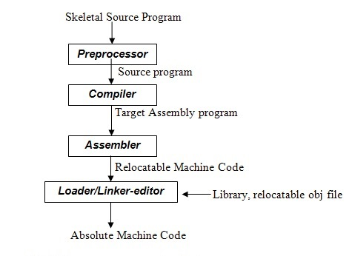
Steps for Language Processing System

Slide 3
Preprocessor
The preprocessor scans the source code and includes the header files which contain relevant information for various functions . source program is collected by a separate program.
E.g. # include<math.h>, #define PI .14

Slide 4
Compiler
The modified source program is then fed to a compiler. The compiler may produce an assembly-language program as its output. because assembly language is easier to produce as output and is easier to debug.
Eg :- GNU Compiler Collection, Javac , Clang

Slide 5
Assembler
The assembler converts the assembly code into relocatable machine code or object code. Although this code is in 0 and 1 form, but it cannot be executed because this code has not been assigned the actual memory addresses.

Slide 6
Linker
The linker resolves external memory addresses, where the code in one file may refer to a location in another file. Large programs are often compiled in pieces, so the relocatable machine code may have to be linked together with other relocatable object files and library files into the code that actually runs on the machine

Slide 7
Loader
Puts together all of the executable object files into memory for execution.

